Slide 1

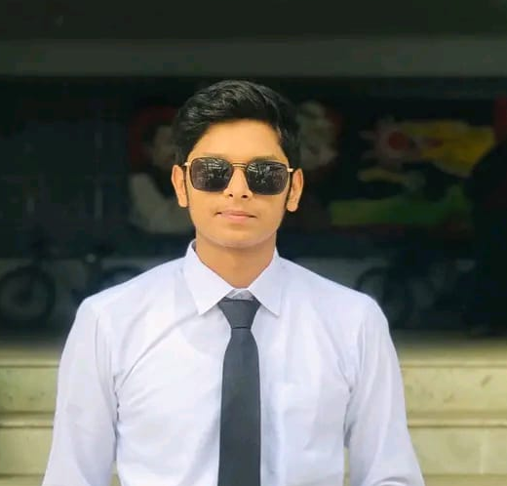



01751103527
mdmominulislam9627@gmail.com
Limon Hossain
01518975153
Entrepreneur
Dallpotti mor, Sutrapur, Dhaka

